Slide 1
Feature Extraction and Feature Engineering
3
Notes:
Hello everybody. Welcome to Module 3, Feature Extraction and Feature Engineering. My name is Haiying Li, the Program Manager for the Online Master’s Learning Analytics Program at the University of Pennsylvania. In this module, we will discuss what feature extraction and feature engineering are and their important role in machine learning.

Slide 2
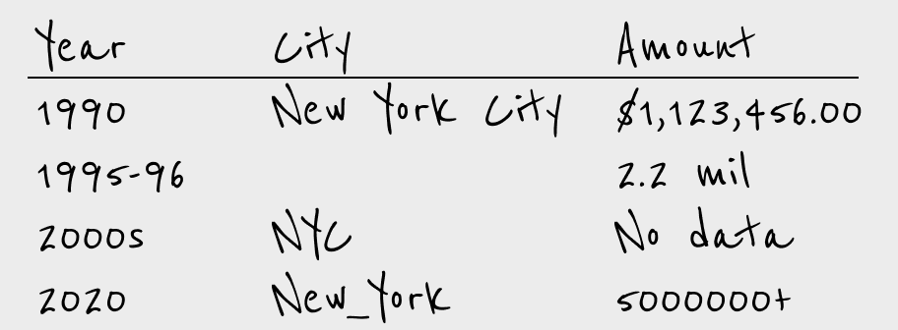
Raw Data
Figure 4.1: More often than not, raw data looks messy.
Dougherty & IIyankou, 2023
4
Notes:
In the real world, the raw data we collect or access is often messy or contains errors. Analysts are always committed to data preprocessing for around 50-80% of their efforts and sometimes even more, throughout the analytics process. The quality of feature engineering significantly influences the accuracy of the model.

Slide 3
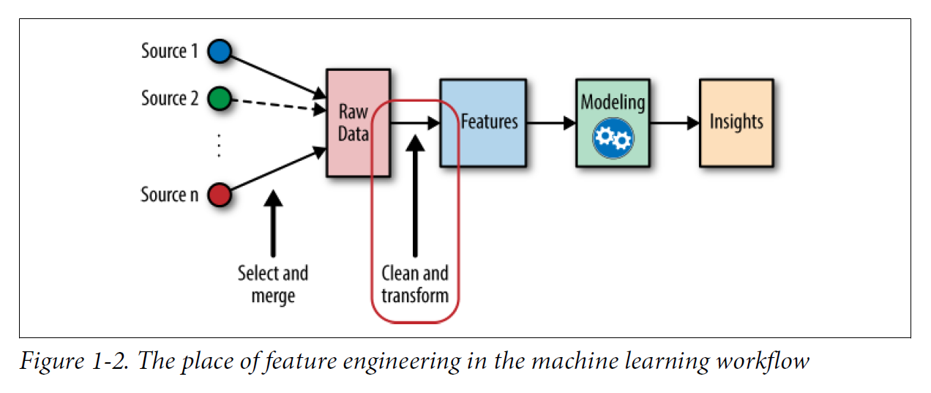
Machine Learning Pipeline
Admissions
Registrar
Zheng & Casari, 2018
LMS
Romero, Romero, & Ventura, 2014
15
Notes:
Data transformation involves the creation of new features from existing ones to enhance model accuracy. In the upcoming videos, we will talk about the techniques and applications related to feature extraction and feature engineering.

Slide 4
Final Thoughts
Feature extraction and feature engineering are a crucial step in the modeling process.
It requires patience as it can be time-intensive.
16
Notes:
Feature extraction and feature engineering are crucial in the modeling process because the right features make modeling easy and yield high-quality models.
It requires patience during this step, for it takes a lot of time and effort to obtain efficient features.
Thank you very much! I will see you in the next video.

